Slide 1

AI for Scientific Literature Layout Conductor : Improving Accessibility @Semantic Scholar
Swapnil Parekh: Machine Learning Engineer
Xinqi Zou: Researcher
Tiyas Dey: Coordinator

Slide 2
Introduction
In Coordination with
AllenAI Lead Scientist @ Sematic Scholar - Kyle Lo
Pdf file is like a screenshot which loses the structural information of the file
Results
LayoutConductor to be added to current Open-source Semantic Scholar library to parse academic papers as PDFs and output bounding boxes of the correct layout reading order (like a conductor maintains order in an orchestra)
Problems
Stitching Layout Elements in the appropriate order is often difficult due to elements like tables/figures obstructing the flow of text paragraphs
Accurate reading flow is important for accessible pdf reading to assist disabled users

Slide 3

Our Task
AllenAI's Semantic Scholar is a scientific platform with sophisticated pdf readers to parse scientific documents.
They currently don't have a tool to decide the reading order built into their current pipeline, causing incorrect placement of tables/figures and reading order.
This harms the read-abililty of such documents by screen-readers for disabled users (blind/ partially deaf).
What we do:
Decide whether the paper is one-column format or two-column format
Decide the reading order of the paper columns.
Decide insertion of picture and tables, especially considering ancillary text such as captions and table footnotes
Combine and resolve multiple layout detection models for accurate reading order prediction
Remove unnecessary hyphenation at the end of the line

Slide 4
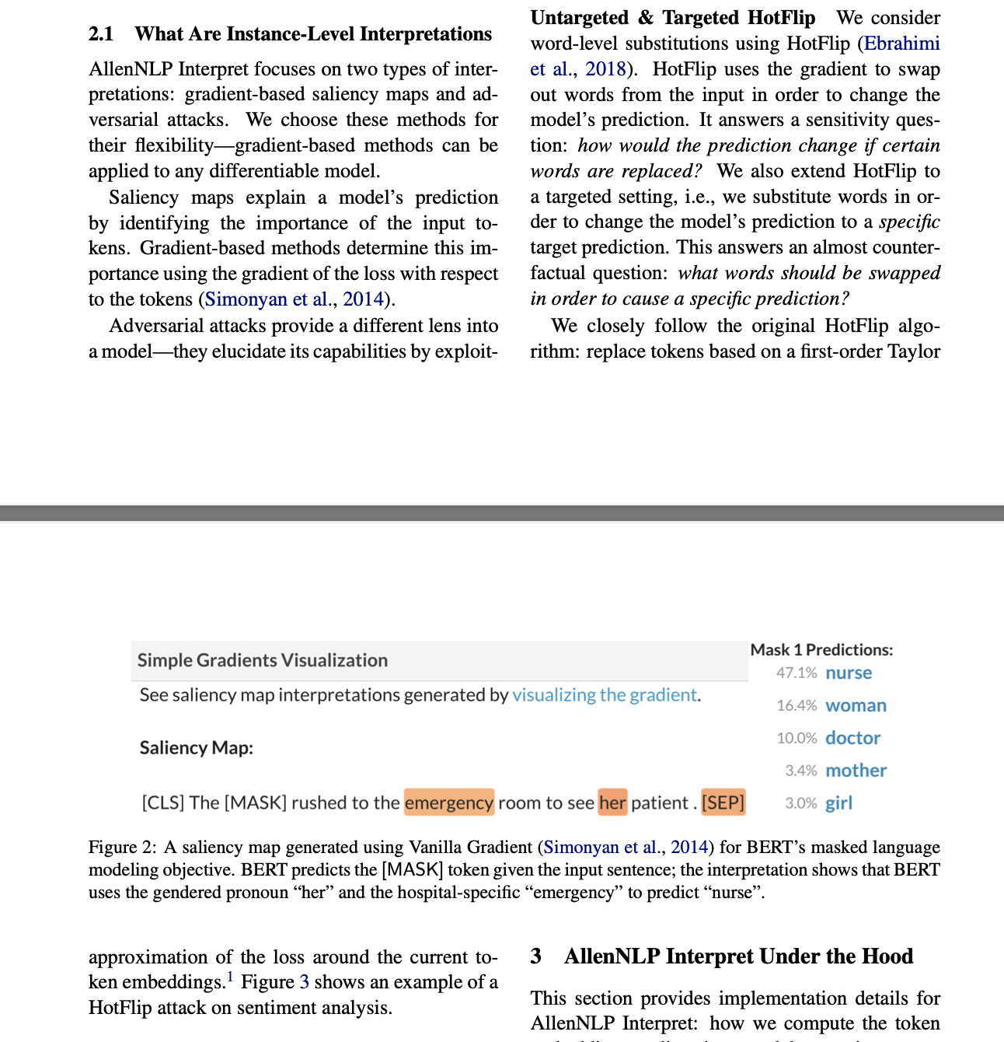
The Problem: Examples from Semantic Scholar
TEXT RENDER ACCORDING TO SEMANTIC SCHOLAR
We closely follow the original HotFlip algorithm: replace tokens based on a first-order Taylor Figure 2 : A saliency map generated using Vanilla Gradient (Simonyan et al., 2014) for BERT's masked language modeling objective. BERT predicts the [MASK] token given the input sentence; the interpretation shows that BERT uses the gendered pronoun "her" and the hospital-specific "emergency" to predict "nurse". approximation of the loss around the current token embeddings. 1 Figure 3 shows an example of a HotFlip attack on sentiment analysis.
=> Here we can see that PDF converter does not detect that the image caption should not be reread, and disrupts the flow of the text.

Slide 5
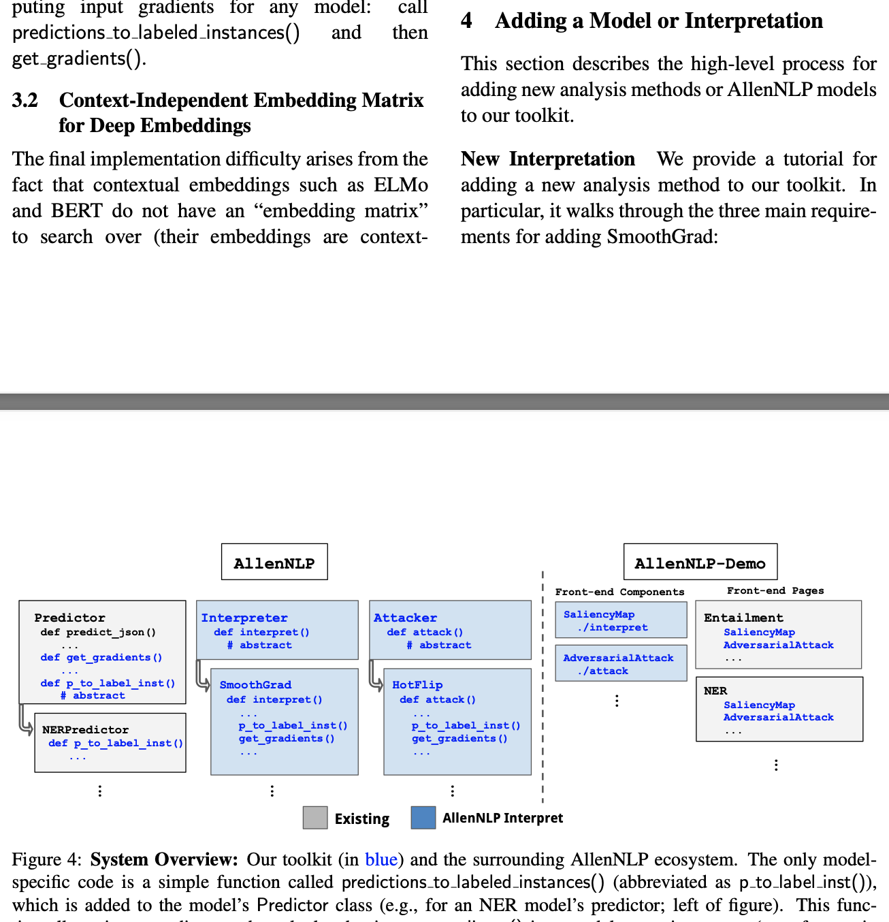
The Problem: Examples from Semantic Scholar
TEXT RENDER ACCORDING TO SEMANTIC SCHOLAR
This section describes the high-level process for adding new analysis methods or AllenNLP models to our toolkit.
New Interpretation We provide a tutorial for adding a new analysis method to our toolkit. In particular, it walks through the three main requirements for adding SmoothGrad: ... … Allennlp Interpret
Figure 4: System Overview: Our toolkit (in blue) and the surrounding AllenNLP ecosystem. The only modelspecific code is a simple function called predictions to labeled instances() (abbreviated as p to label inst()), which is added to the model's Predictor class (e.g., for an NER model's predictor; left of figure). This function allows input gradients to be calculated using get gradients() in a model-agnostic manner (e.g., for use in
=> Here we can see that PDF converter reads ELLIPSES from the image and also the caption which incorrectly obstruct reading-order

Slide 6
Our Solution – Layout Conductor
To establish the reading order, our approach is to combine multiple layout element prediction models to remove Tables/ Figures/ Captions/ related-footnotes from the reading flow followed by Clustering.
We use 3 predictive models:
Layout Detector Mask RCNN (block wise) - detects tables/figures/text/lists/titles
Visual Layout Extractor (token wise) - detects token level element type
PDF-Figures2 (figure-level) - detects figures/tables/captions
Layout Conductor Algorithm:
Thresholded-intersection based resolution algorithm to resolve conflicts between different model outputs.
We use text-similarity metrics to eliminate repeated text throughout the doc (like headers).
We use Hierarchical Clustering to cluster nearby bounding boxes together.
Hierarchical Clustering(HC) steps:
Using the bounding box coordinates, compute pairwise l1-norm for HC
Based on the cluster labels, iteratively merge the bounding boxes by taking min( x1,y1) and max(x2,y2) for them

Slide 7
The Problem Revisited
TEXT RENDER ACCORDING TO SEMANTIC SCHOLAR
We closely follow the original HotFlip algorithm: replace tokens based on a first-order Taylor Figure 2 : A saliency map generated using Vanilla Gradient (Simonyan et al., 2014) for BERT's masked language modeling objective. BERT predicts the [MASK] token given the input sentence; the interpretation shows that BERT uses the gendered pronoun "her" and the hospital-specific "emergency" to predict "nurse". approximation of the loss around the current token embeddings. 1 Figure 3 shows an example of a HotFlip attack on sentiment analysis.
=> Here we can see that PDF converter does not detect that the image caption should not be reread, and disrupts the flow of the text.

Slide 8
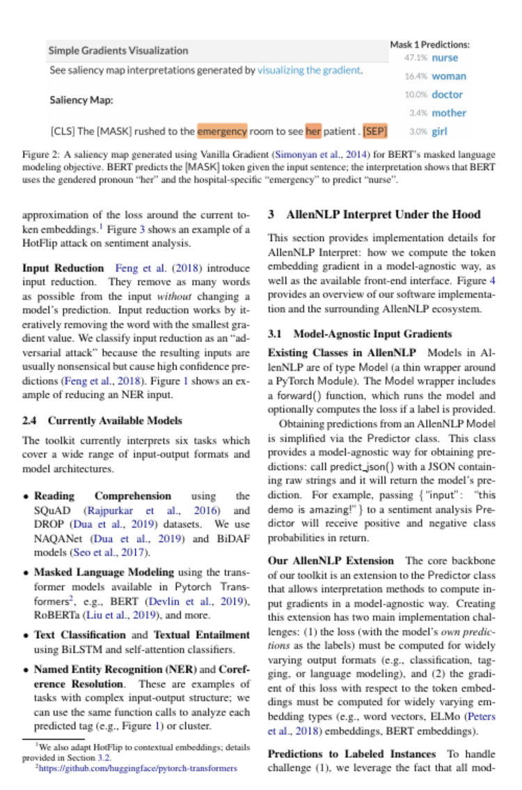
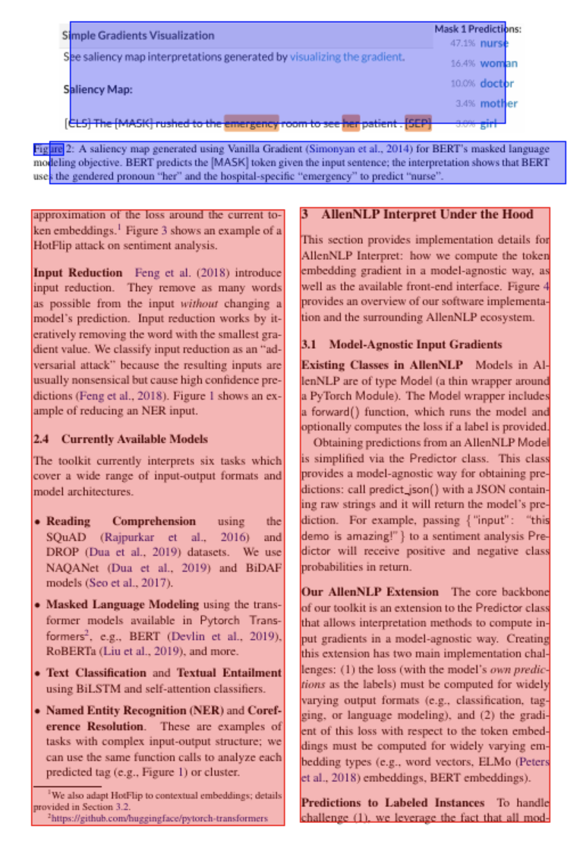
Layout Conductor Example 1:

Slide 9
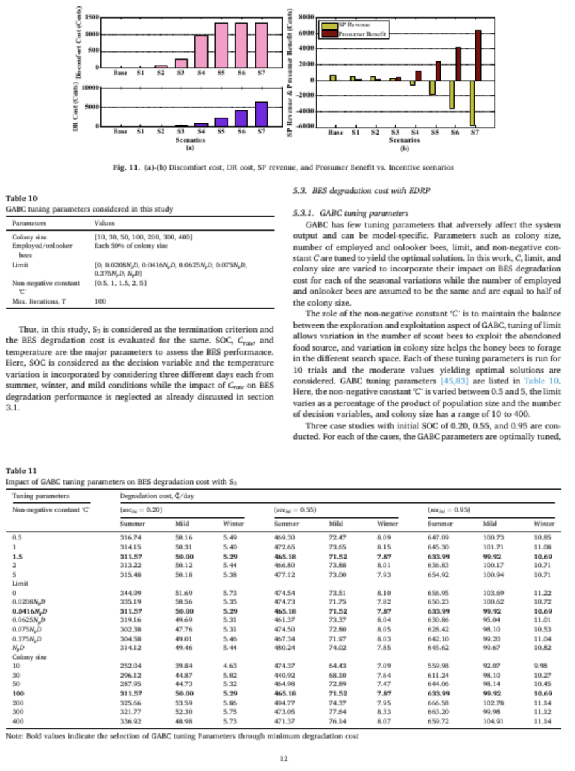
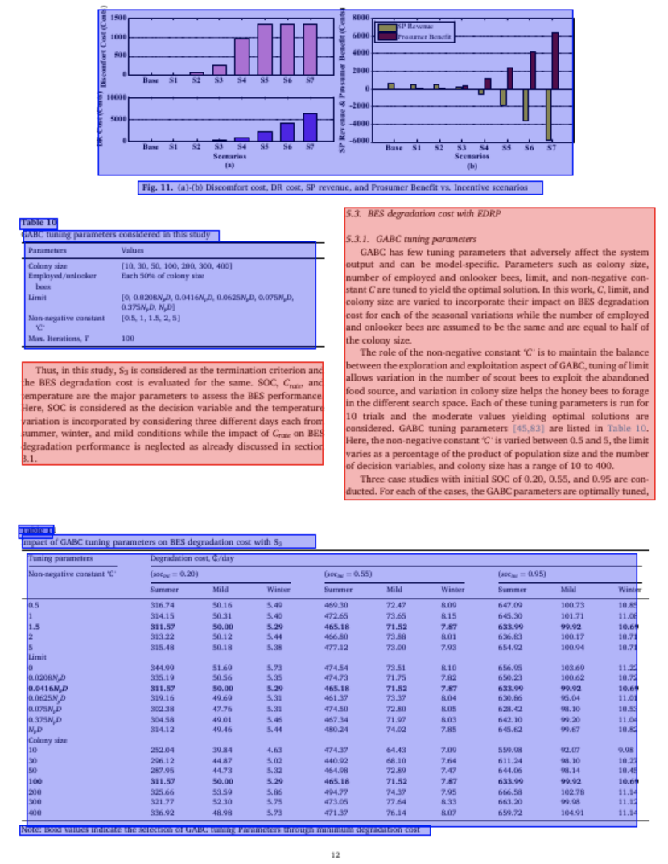
Layout Conductor Example 2: More complex layouts

Slide 10
UI-based Model Evaluation
To evaluate our model outputs, we developed an application/UI to help score model outputs for each page of a PDF, on a scale of 1-3
Annotation Criteria:
1: if a page has a lot of missing layout elements/ misclassified
2: if a page has just a few components not captured/ mistakes
3: a page is nearly perfectly segmented and not more than 1-2 lines of mistakes.
Annotation Results : ~15 documents
Average Annotation Score
2.65/3

Slide 11
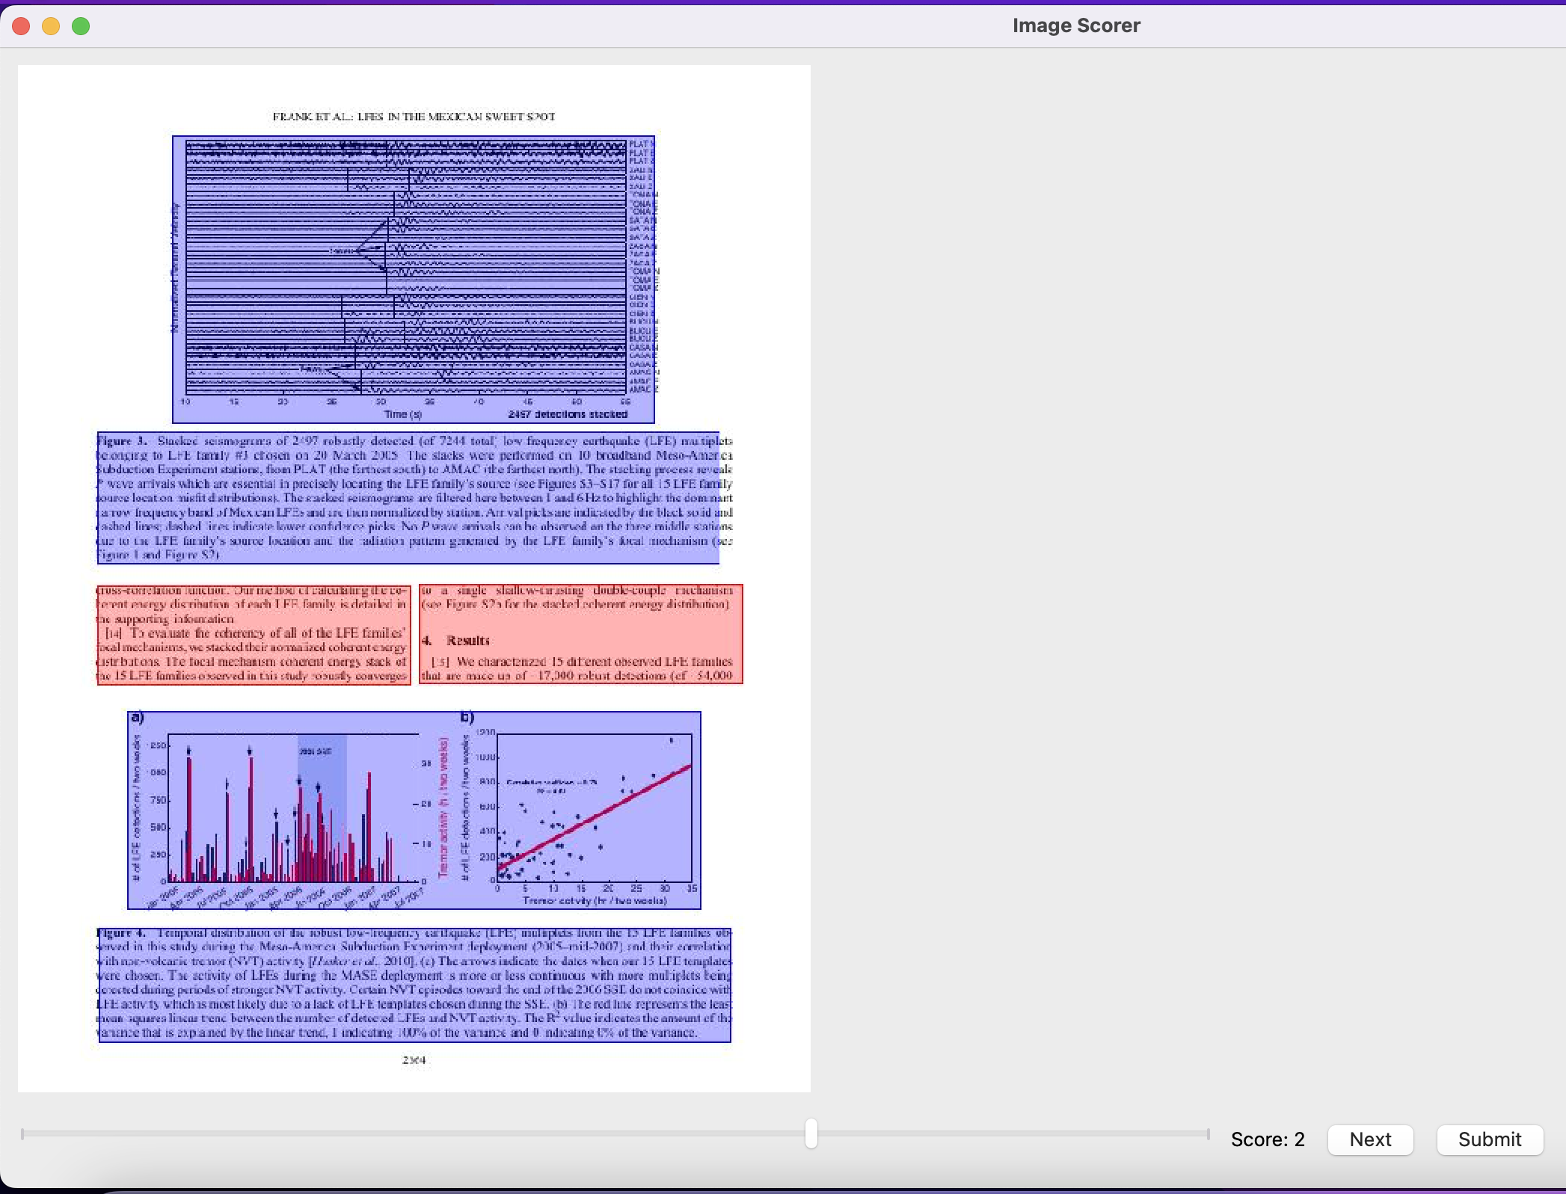
UI-based Model Evaluation

Slide 12
Final deliverables
Layout Conductor helps improve pdf reader accessibility for disabled users
Github PR to the Semantic Scholar codebase
Accurate licensing and documentation to facilitate productionizing of the code for AllenAI
UI evaluation framework + scores to facilitate future improvements to the models

Slide 13

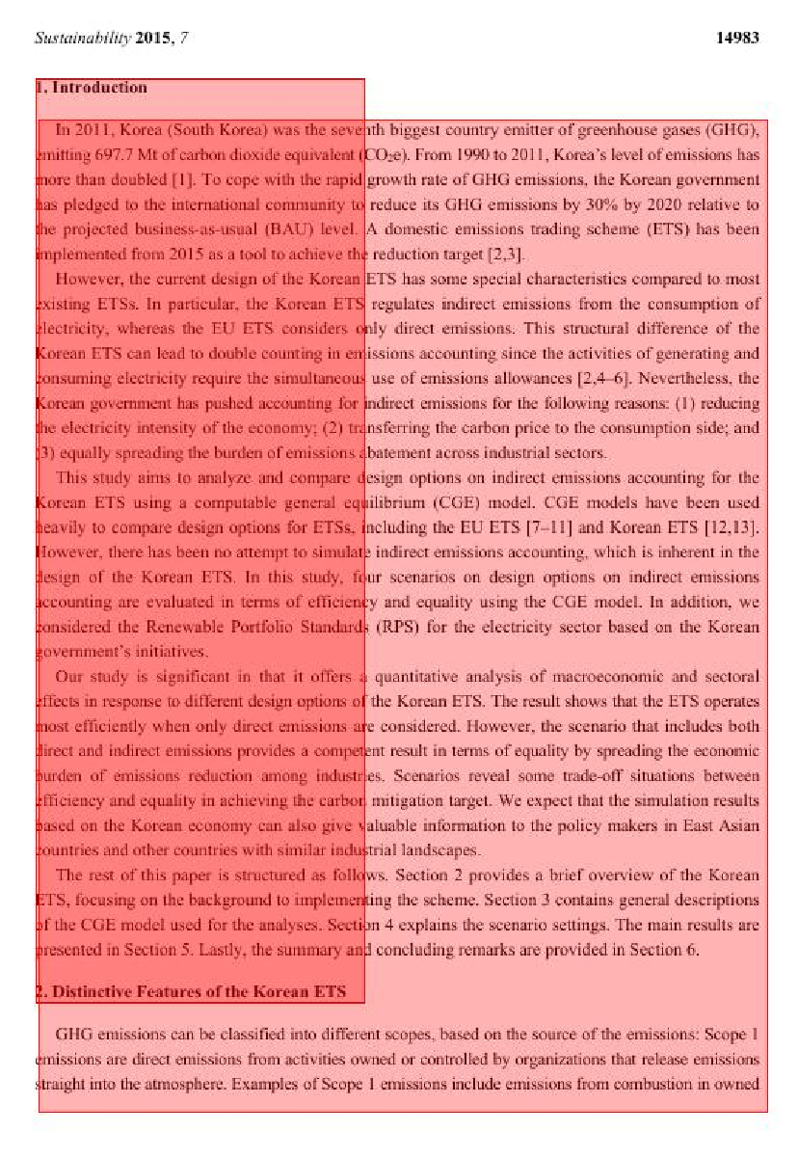
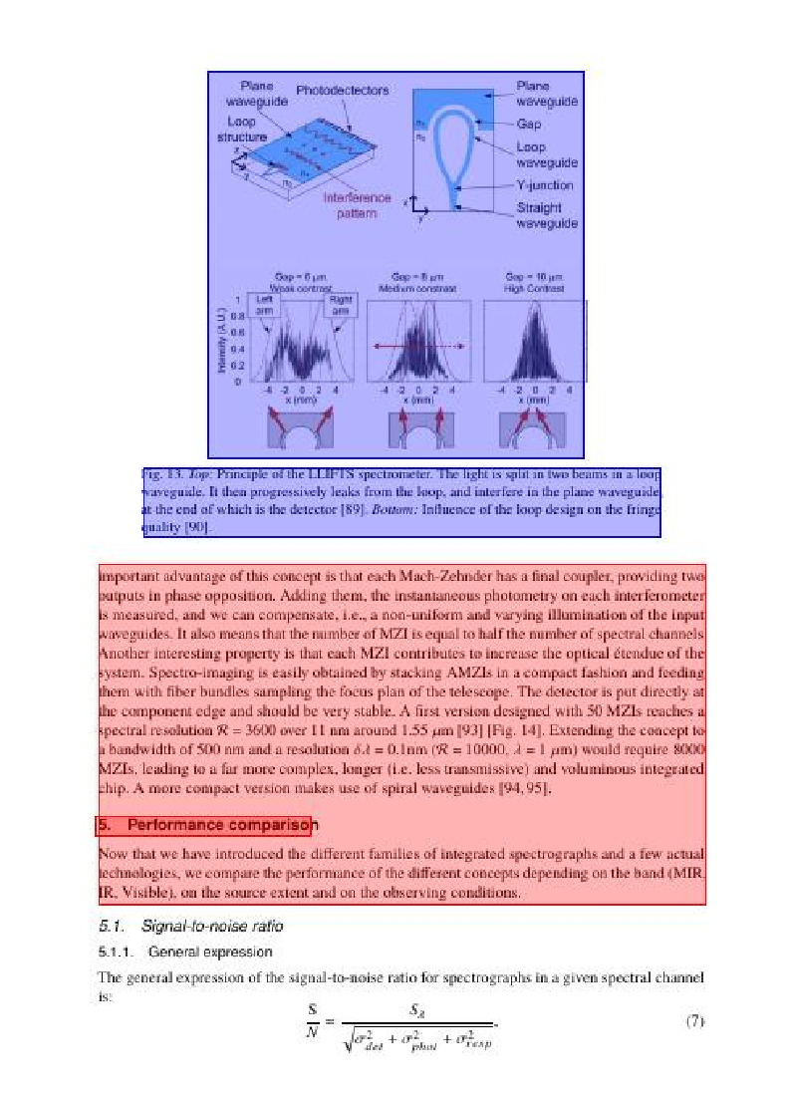
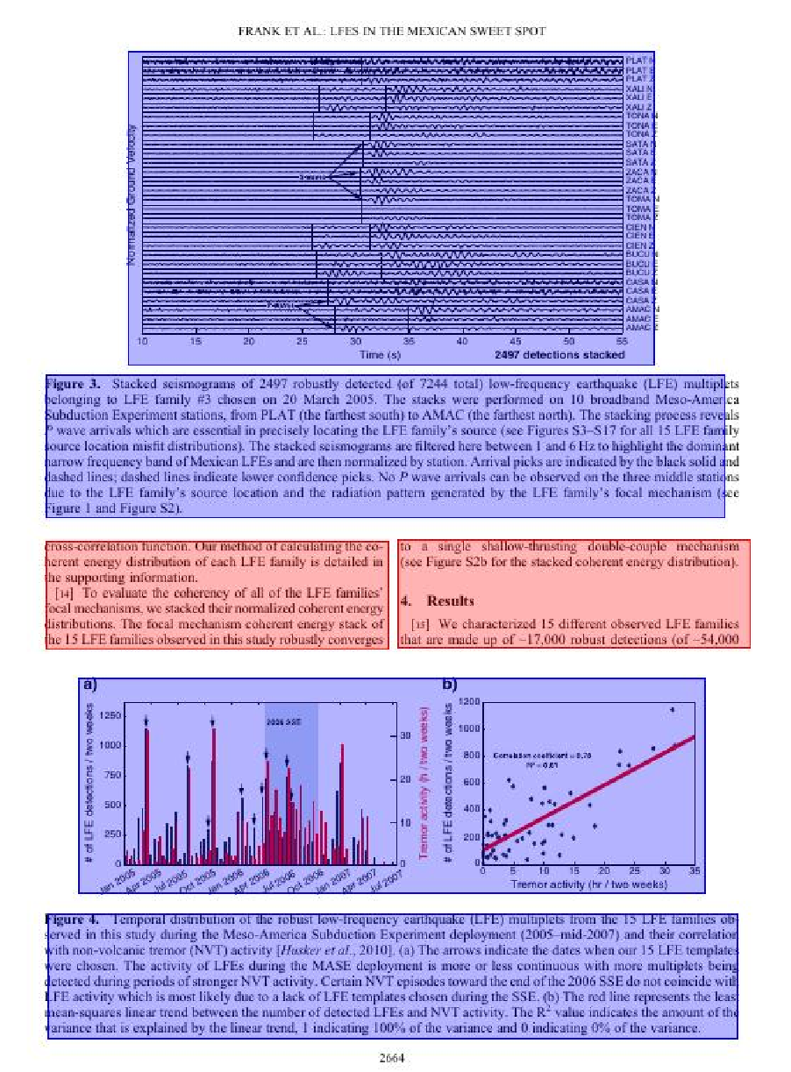
Examples of Annotation
0
1
2
3

Slide 14
Solving the Hyphenation Problem
Metric | Detection Accuracy | Examples
Correct hyphenation | .9875 | Brother-in-law, check-in
Incorrect hyphenation | 1.0 | Avail-able, te-xt, sci-entific
Using a character language model's perplexity score with and without the hyphen, we can identify whether a word is correctly or incorrectly hyphenated.
Initial Eval results:
Testing our algorithm on ~100 correctly hyphenated words(compound words) and randomly generated incorrectly hyphenated words
Caveat: unclear how it will perform on scientific acronyms in these pdfs, next stage of evals on actual terms from scientific pdfs

Slide 15
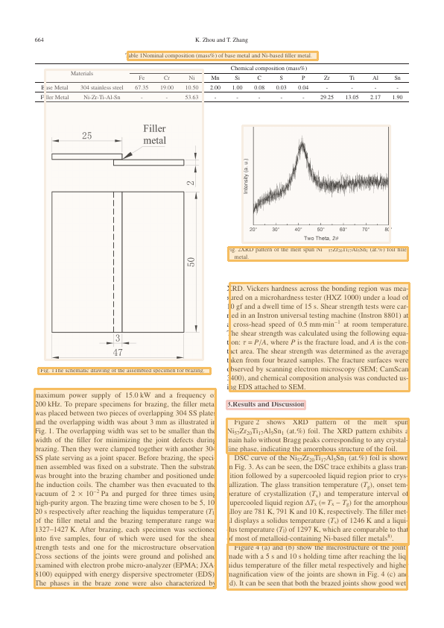
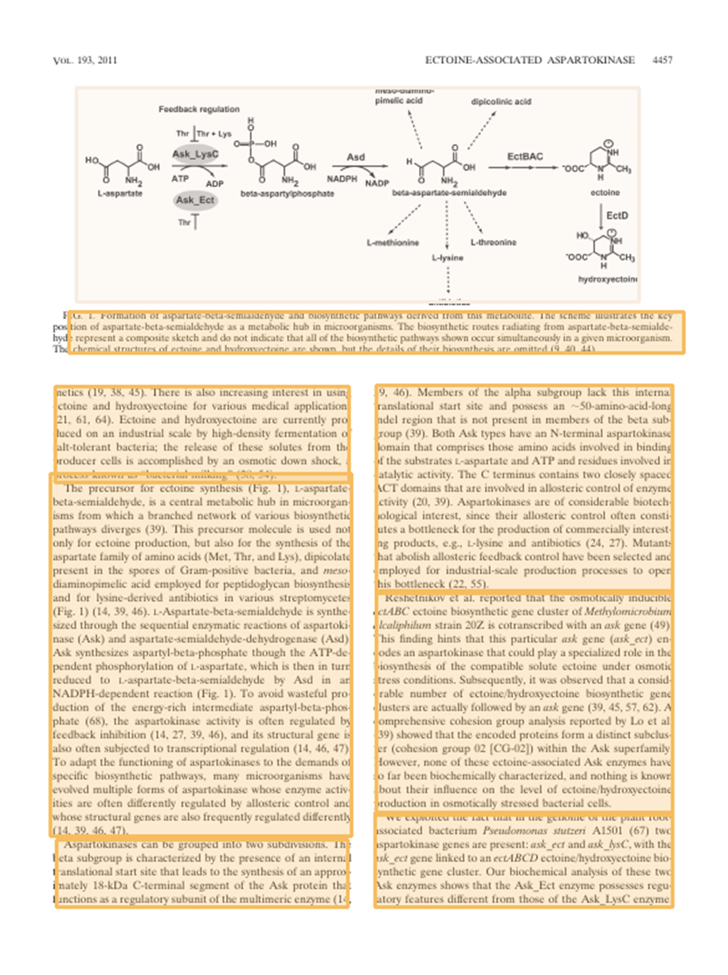
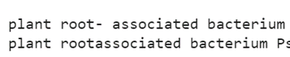

Evaluation- hyphenation removal sample
correct
incorrect

Slide 16
Evaluation- hyphenation removal
Goal: correctly remove unnecessary hyphenation at the end of lines
Method:
Check each sentence where hyphenation is removed and decide whether it is reasonable

